Slide 1
Duke Dementia Family Support Program
Caregiver Connections
An Educational Webinar Series with the Experts
The presentation will begin shortly.
dukefamilysupport.org
919-660-7510

Slide 2
The Medication Minefield
Understanding Risky Drugs & Behavioral Symptom Treatments in Dementia
Tasha Woodall, PharmD, BCGP, CPP, FNCAP

Slide 3
Drug-Induced Cognitive Impairment
Notes:
How do drugs cause cognitive problems to get worse?

Slide 4
Can Show Up in Many Different Ways
Memory Impairment
Confusion
Disorientation
Attention/Focus
Slowed Processing
Language Difficulties
Reduced Decision- Making Capacity
Motor Slowness
Delayed Responses
Notes:
•Can mimic any type of cognitive impairment caused by disease or aging à easy to misinterpret as sx of a new or worsening chronic condition
•Language difficulties – problems with word finding
•Executive dysfunction – complex problem-solving, decision making, planning, organizing
•May appear shortly after starting a new drug, but can appear at any time during treatment, even after long-term use of several years
•Often but not always reversible upon drug taper (may persist if structural changes have occurred)

Slide 5
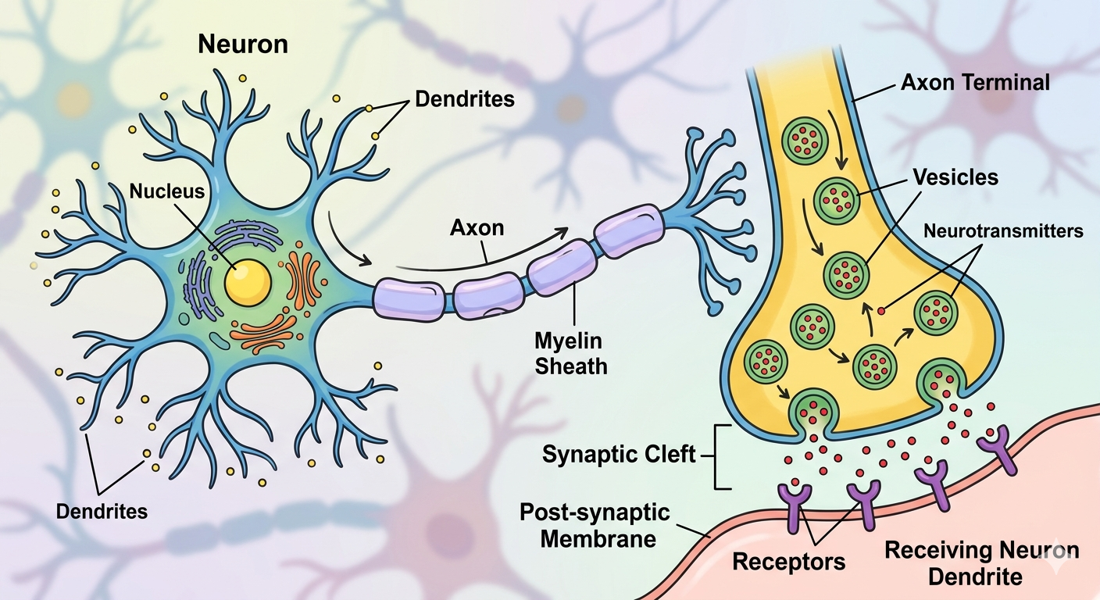
Pathway #1: Anticholinergic Activity
As we age, the number of functioning cholinergic neurons decreases
Notes:
When medications further reduce the availability of critical neurotransmitters/brain chemicals, the brains ability to buffer and maintain normal function is diminished

Slide 6
Common Anticholinergic Drugs
Antidepressants
Older Antihistamines
Muscle Relaxants
Paroxetine
Amitriptyline
Imipramine
Nortriptyline
Desipramine
Diphenhydramine
Doxylamine
Hydroxyzine
Chlorpheniramine
Meclizine
Cyclobenzaprine
Methocarbamol
Baclofen
Carisoprodol
Metaxolone

Slide 7
Anticholinergic Cognitive Burden (ACB) Scale
Assigns medications 1, 2, or 3 points based on how anticholinergic they are
Higher scores have been associated with:
More cognitive side effects
Higher risk of dying earlier

Slide 8
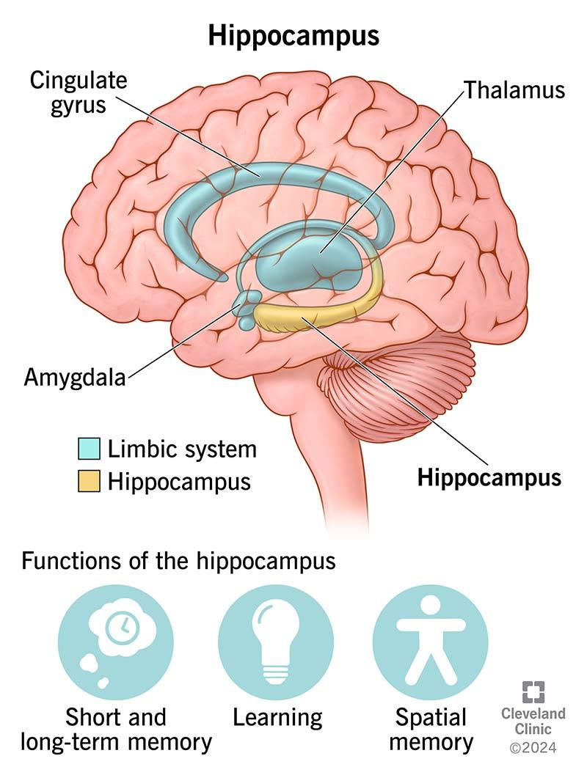
Pathway #2: Sedating the Brain
Drugs commonly used for sleep, anxiety, or pain amplify the depressive effect of GABA
and accelerate volume loss in the hippocampus.
Often improves upon discontinuation, but can persist.
Notes:
•Hippocampus: found in medial temporal lobe, plays an important role in converting short-term memories to long-term storage (memory consolidation), spatial navigation (finding our way around familiar environments), and processing emotions

Slide 9
Sedative Hypnotics
Benzodiazepines
“Z-Drugs”
Alprazolam
Clonazepam
Lorazepam
Temazepam
Diazepam
Zolpidem
Zaleplon
Eszopiclone

Slide 10
Opioids
Regular use is associated with higher risk of dementia in those with chronic pain
May be exposure-dependent (i.e., higher dose, longer duration)
Can be difficult to assess:
Chronic pain | Decreased attention Inflammation and stress
Opioid use | Sleep disturbances Mood changes Social isolation
Notes:
•Exposure = dose or duration
●Chronic pain itself can contribute to cognitive decline due to mechanisms like decreased attentional capacity and stress-related pathways.
●Other opioid-related factors: Opioid use may lead to sleep disturbances, mood changes, and social isolation, which can indirectly impact cognitive function

Slide 11
Other Possible Culprits
Dopamine agonists (pramipexole, ropinirole)
Steroids (prednisone)
NSAIDs (ibuprofen, naproxen)
Statins (simvastatin, atorvastatin)
Blood pressure medications
“Newer” antidepressants (sertraline, duloxetine)
Antipsychotics (haloperidol, quetiapine)
Proton pump inhibitors (omeprazole, pantoprazole)
Chemotherapy agents
Antiseizure medications (topiramate, gabapentin)
Notes:
•Antiseizure: amplification of GABA, reduced neuronal excitability
•Antidepressants: hyponatremia, DA/NE overstimulation
•DA agonists: disturbed DA/Ach balance
•Lithium: usually associated with high plasma concentrations
•PPI: reduced B12 absorption, etc.
•Glucocorticoids: reversible hippocampal impairment, may become irreversible with chronic exposure
•NSAIDs: cerebral hypoperfusion through vasoconstriction or thrombophilia
•Statins: impaired cell membrane function, impaired myelin function, dec cholesterol in hippocampus (inconclusive à some studies suggest a possible PROTECTIVE effect against dementia)
•Antihypertensives: white and grey matter damage from cerebral hypoperfusion
•Chemo: proinflammatory cytokine induction, oxidative stress, damage to BBB

Slide 12

General Anesthesia
May accelerate decline in vulnerable individuals (i.e., those with dementia)
  Structural brain changes → lower cognitive scores
Difficult to distinguish between influence of anesthesia and effect of surgery itself
Notes:
Structural brain changes: transiently dec white matter volume
Confounders: comorbidities, surgical indication, perioperative complications

Slide 13
Medications for Behavioral Symptoms

Slide 14
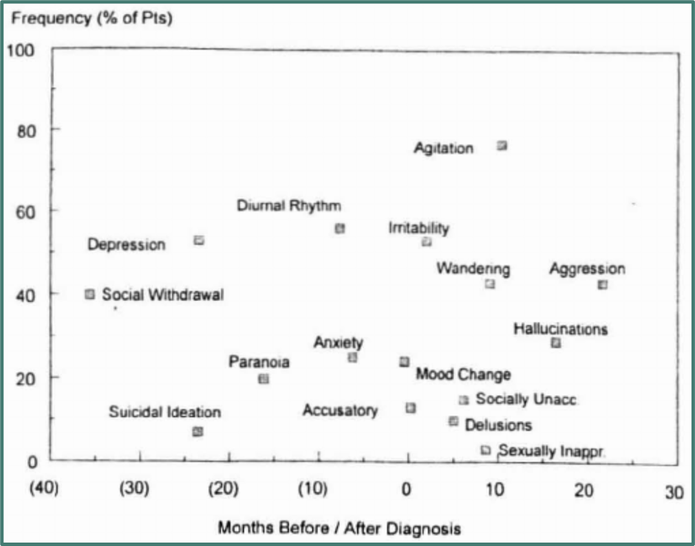
Time of Diagnosis
Notes:
>90% will experience some form
Many often already occurring at time of dx (may be what prompts further evaluation leading to dx)

Slide 15
Antipsychotics
(risperidone, quetiapine, aripiprazole, olanzapine, brexpiprazole, pimavanserin, etc.)
None are FDA-approved for dementia-related behaviors except brexpiprazole
Vary in their effectiveness for a range of behavioral symptoms
  Most studied for psychosis, agitation, aggression
Weigh benefits vs. risks:
  Abnormal movements, sedation, steeper cognitive decline, premature death
↘
Attempt gradual withdrawal when and if possible.
If initially unsuccessful, reattempt at regular intervals.
Boxed warning: (1-2%) increased risk of death;
highest during first month of use, sustained for up to 2 years
Notes:
Limited evidence suggests stopping antipsychotics may be done without making behavior worse.
AP withdrawal may result in worsening of behavior if symptom improvement was more significant initially.
Drugs may be easier to stop in people with milder symptoms at baseline.

Slide 16
Mood Stabilizers
(carbamazepine, valproic acid, etc.)
Evidence is shaky
Weigh benefits vs. risks:
  Sedation
  Abnormal movements
  Steeper cognitive decline
  Dizziness
  Drug-drug interactions

Slide 17
Antidepressants
(citalopram, etc.)
May be modestly effective for agitation
Most preferred:
  Citalopram/escitalopram (more calming)
  Sertraline (more activating)
Less preferred:
  Bupropion (can worsen anxiety, psychosis)
  Paroxetine (anticholinergic)
Notes:
May “bridge” SSRI with antipsychotic for first few weeks to allow it time to reach maximal effect

Slide 18
Before Filling the Prescription…
1
Understand the goal.
What specific behavior are you trying to address?
Is it causing distress for the person with dementia?
2
Know what alternatives exist.
Have underlying causes been ruled out?
Are there environmental changes you haven’t tried yet?
3
Discuss a plan for deprescribing.
When do risks outweigh benefits?
Notes:
Questions to ask the prescriber:
Understand the goal
Is the medication for aggression, sleep disturbance, anxiety, hallucinations, other?
Alternatives
Rule out UTI, uncontrolled pain, dehydration, low/high blood sugar, etc.
Changes in lighting, noise levels, daily routine
Deprescribing
When and how will prescriber attempt to taper off the med?
Have a clear definition of unacceptable side effects (e.g., excessive sedation, mobility changes, etc.)

Slide 19
Thank You!
Ask me questions!
Tasha.Woodall@mahec.net

Slide 20
Duke Dementia Family Support Program
Caregiver Connections
An Educational Webinar Series with the Experts
Thank you for joining us today!
dukefamilysupport.org
919-660-7510

